Slide 1
Notes:
Chapter Six
Developing a Project Plan

Slide 2
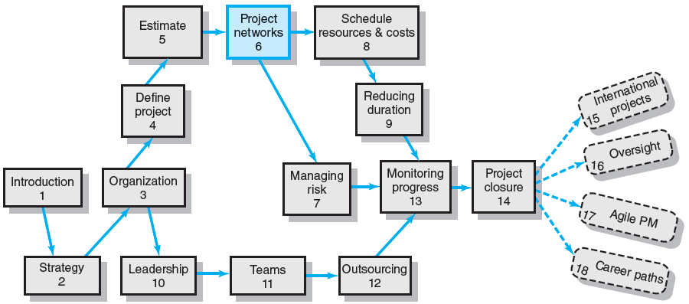
Where We Are Now
Notes:
Where We Are Now
Many project managers feel the project network is their most valuable exercise and planning document. Project networks sequence and time-phase the project work, resources, and budgets. Work package tasks are used to develop activities for networks. Project networks help to ensure there are no surprises due to overlooked process steps or out-of-sequence activities.

Slide 3
Developing the Project Plan
The Project Network
A flow chart that graphically depicts the sequence, interdependencies, and start and finish times of the project job plan of activities that is the critical path through the network.
Provides the basis for scheduling labor and equipment.
Enhances communication among project participants.
Provides an estimate of the project’s duration.
Provides a basis for budgeting cash flow.
Identifies activities that are critical.
Highlights activities that are “critical” and can not be delayed.
Help managers get and stay on plan.
Notes:
The project network is the tool used by managers for planning, scheduling, and monitoring project progress. It depicts the project’s activities, its sequences, interdependencies, and times for the activities to start and finish and identifies its critical path.

Slide 4
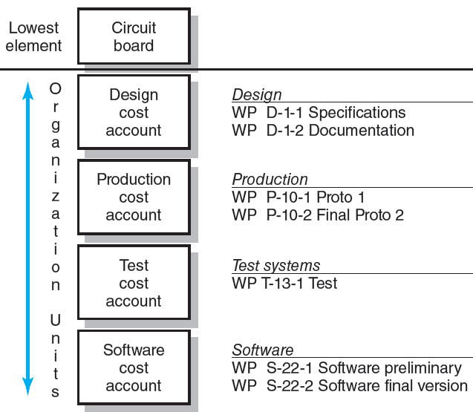
WBS/Work Packages to Network
FIGURE 6.1
Notes:
Figure 6.1 traces how work packages in the work breakdown structure (WBS) are used to develop a project network. Each cost account represents one or more work packages. For example, the design cost account has two work packages (D-1-1 and D-1-2)—specifications and documentation. The software and production accounts also have two work packages. Developing a network requires sequencing tasks from all work packages that have measurable work.

Slide 5
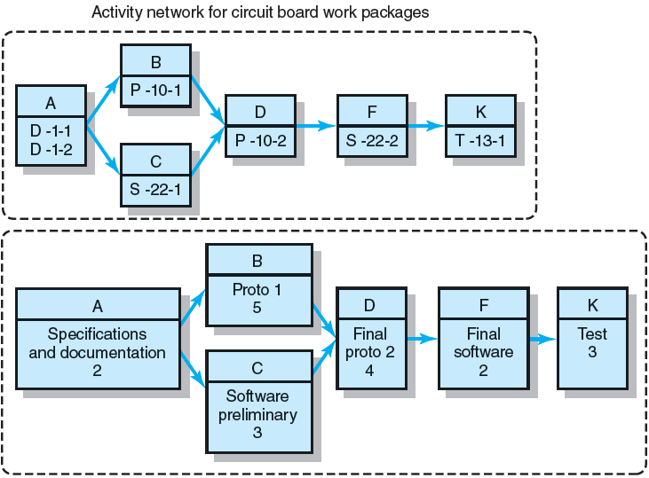
WBS/Work Package to Network (cont’d)
FIGURE 6.1 (cont’d)
Notes:
Figure 6.1 (cont’d) shows the coding scheme of a segment of the WBS example and how the information is used to develop a project network beginning with the lowest-level deliverable.

Slide 6
Constructing a Project Network
Terminology
Activity: an element of the project that requires time.
Merge Activity: an activity that has two or more preceding activities on which it depends.
Parallel (Concurrent) Activities: Activities that can occur independently and, if desired, not at the same time.
A
B
D
C
Notes:
Every field has its jargon that allows users to communicate comfortably with each other about the techniques they use. Terms commonly used in building project networks are:
Activity: an element of the project that requires time.
Merge Activity: an activity that has two or more preceding activities on which it depends.
Parallel (Concurrent) Activities: Activities that can occur independently and, if desired, not at the same time.

Slide 7
Constructing a Project Network (cont’d)
Terminology
Path: a sequence of connected, dependent activities.
Critical path: the longest path through the activity network that allows for the completion of all project-related activities; the shortest expected time in which the entire project can be completed. Delays on the critical path will delay completion of the entire project.
C
A
B
D
(Assumes that minimum of A + B > minimum of C in length of times to complete activities.)
Notes:
Every field has its jargon that allows users to communicate comfortably with each other about the techniques they use. Additional terms commonly used in building project networks are:
Path: a sequence of connected, dependent activities.
Critical path: the longest path through the activity network that allows for the completion of all project-related activities; the shortest expected time in which the entire project can be completed. Delays on the critical path will delay completion of the entire project.

Slide 8
Constructing a Project Network (cont’d)
Terminology
Event: a point in time when an activity is started or completed. It does not consume time.
Burst Activity: an activity that has more than one activity immediately following it (more than one dependency arrow flowing from it).
Two Approaches
Activity-on-Node (AON)
Uses a node to depict an activity.
Activity-on-Arrow (AOA)
Uses an arrow to depict an activity.
B
A
C
D
Notes:
Every field has its jargon that allows users to communicate comfortably with each other about the techniques they use. Additional terms commonly used in building project networks are:
Event: a point in time when an activity is started or completed. It does not consume time.
Burst Activity: an activity that has more than one activity immediately following it (more than one dependency arrow flowing from it).
Two methods commonly used to develop project networks are activity-on-node (AON) and activity-on-arrow (AOA). The availability of advanced computer graphics improved the clarity and visual appeal of the AON method.

Slide 9
Basic Rules to Follow in Developing Project Networks
Networks typically flow from left to right.
An activity cannot begin until all preceding connected activities are complete.
Arrows indicate precedence and flow and can cross over each other.
Each activity must have a unique identify number that is greater than any of its predecessor activities.
Looping is not allowed.
Conditional statements are not allowed.
Use common start and stop nodes.
Notes:
The basic rules for developing project networks are listed in this slide.

Slide 10
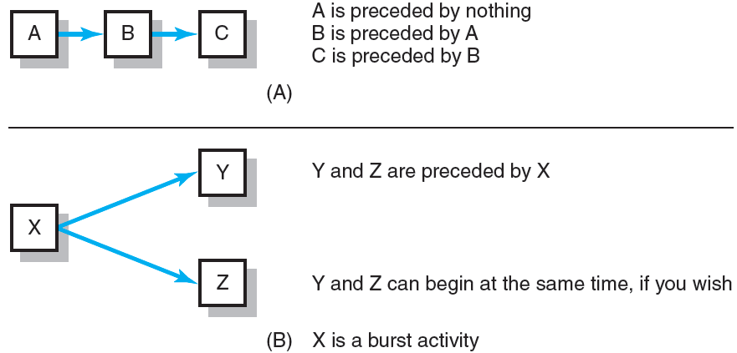
Activity-on-Node Fundamentals
FIGURE 6.2
Notes:
Figure 6.2 shows typical uses of building blocks for the AON network construction. An activity is represented by a node as a rectangle (box). The dependencies among activities are depicted by arrows between the boxes on the AON network. The arrows indicate how the activities are related and the sequence in which things must be accomplished.

Slide 11
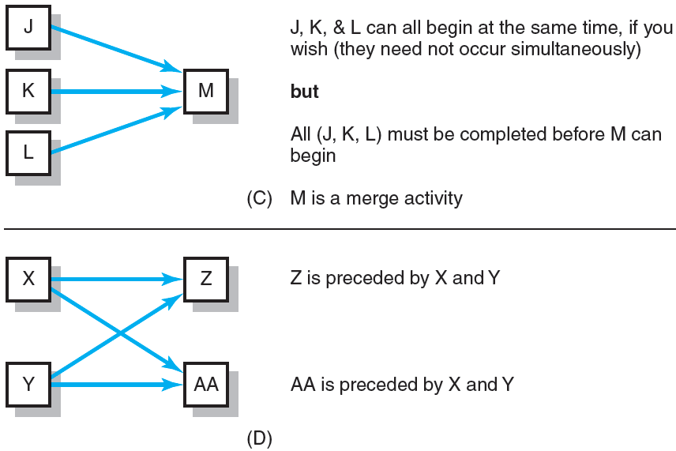
Activity-on-Node Fundamentals (cont’d)
FIGURE 6.2 (cont’d)
Notes:
There are three basic relationships that must be established for activities included in a project network:
1. Which predecessor activities must be completed immediately before this activity? 2. Which successor activities must immediately follow this activity?
3. Which concurrent or parallel activities can occur while this activity is taking place?

Slide 12
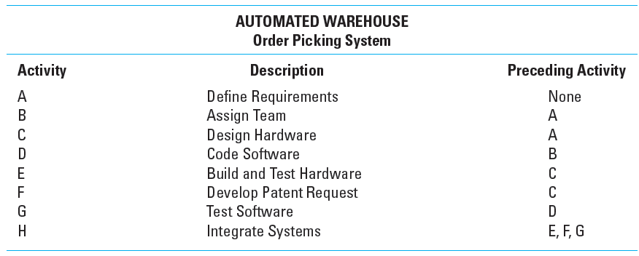
Network Information
TABLE 6.1
Notes:
Information for a simplified project network is given in Table 6.1. This project represents a new automated warehouse system for picking frozen food package orders and moving them to a staging area for delivery to stores.

Slide 13
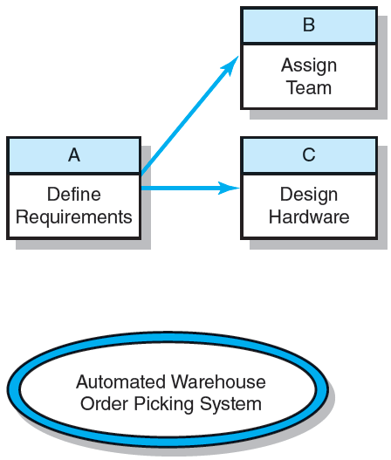
Automate Warehouse—Partial Network
FIGURE 6.3
Notes:
Figure 6.3 shows the first steps in constructing the AON project network from the information in Table 6.1. Activity A (define requirements) has nothing preceding it; therefore, it is the first node to be drawn. Activities B and C are both preceded by activity A. Two arrows are drawn to connect A to activities B and C showing that activity A must be completed before these activities. After A is completed, B and C can take place concurrently, if desired.

Slide 14
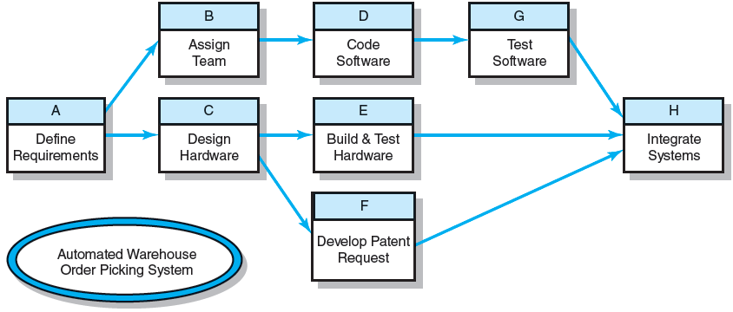
Automated Warehouse—Complete Network
FIGURE 6.4
Notes:
Figure 6.4 shows the completed network with all of the activities sequences and dependencies. A more realistic project plan and schedule requires inclusion of reliable time estimates (durations) for project activities demand for resource in terms of material, equipment, and people.

Slide 15
Network Computation Process
Forward Pass—Earliest Times
How soon can the activity start? (early start—ES)
How soon can the activity finish? (early finish—EF)
How soon can the project finish? (expected time—ET)
Backward Pass—Latest Times
How late can the activity start? (late start—LS)
How late can the activity finish? (late finish—LF)
Which activities represent the critical path?
How long can activity be delayed? (slack or float—SL)
Notes:
Drawing the project network places the activities in the right sequence for computing activity time estimates taken from the task times in the work package. The project manager can complete a process known as the forward and backward pass to establish the earliest and latest time that activities start and finish.

Slide 16
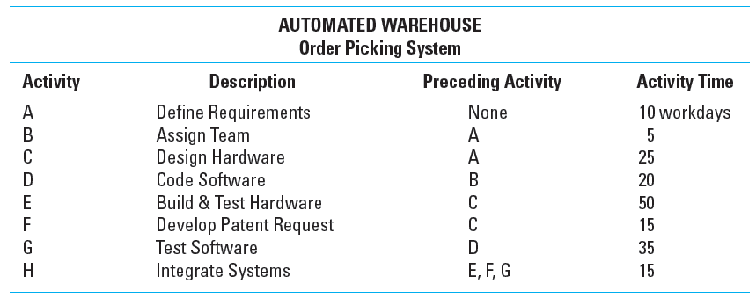
Network Information
TABLE 6.2
Notes:
Table 6.2 lists the activity times in workdays for the Automated Warehouse project example that were used for drawing its network and identifying its critical path (CP).

Slide 17
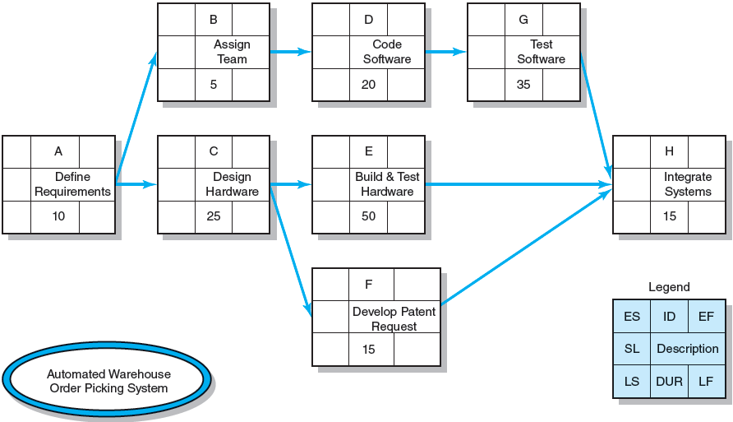
Activity-on-Node Network
FIGURE 6.5
Notes:
Figure 6.5 shows the network with the activity time estimate (duration) for each node (see “DUR” for duration in the legend).

Slide 18
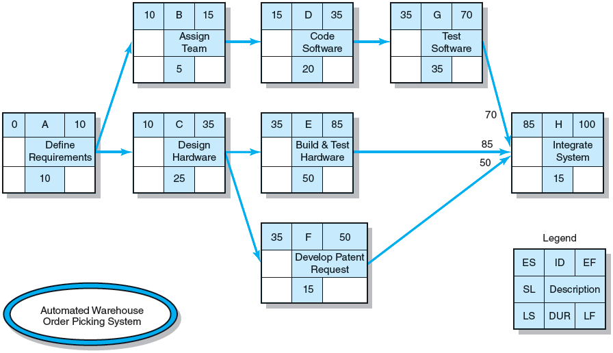
Activity-on-Node Network Forward Pass
FIGURE 6.6
Notes:
In Figure 6.6, activities B and C have an early start (ES) of 10 days. Subsequent activities in the network cannot begin until predecessor or longer duration parallel activities have completed. The Forward Pass process computes the early start (ES), early finish (EF), and the project expected duration (TE) times for activities on the network.

Slide 19
Forward Pass Computation
Add activity times along each path in the network (ES + Duration = EF).
Carry the early finish (EF) to the next activity where it becomes its early start (ES) unless…
The next succeeding activity is a merge activity, in which case the largest EF of all preceding activities is selected.
Notes:
The process for computing forward pass times for activities on a network is listed.

Slide 20
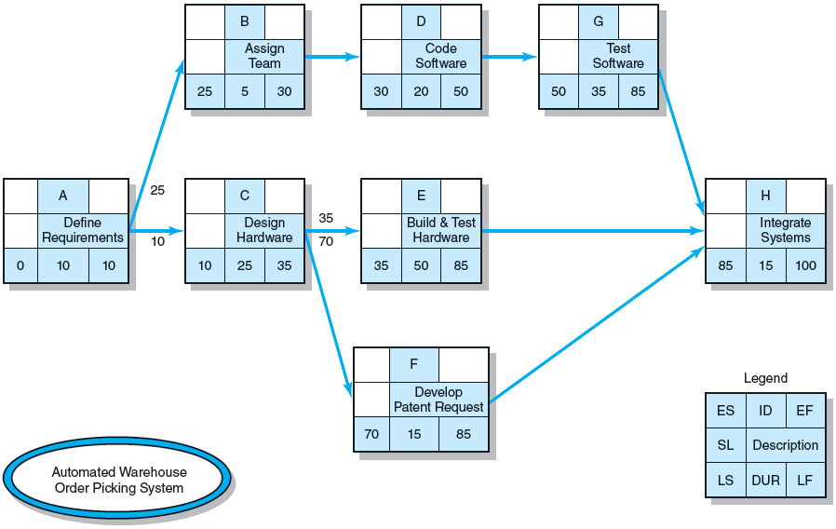
Activity-on-Node Network Backward Pass
FIGURE 6.7
Notes:
In Figure 6.7, the backward pass starts with the last project activity(ies) on the network in tracing backward on each path by subtracting activity times to find the late start (LS) and late finish (LF) times for each activity. Before the backward pass can be computed, the late finish for the last project activity(ies) must be selected.

Slide 21
Backward Pass Computation
Subtract activity times along each path in the network (LF - Duration = LS).
Carry the late start (LS) to the next activity where it becomes its late finish (LF) unless
The next succeeding activity is a burst activity, in which case the smallest LF of all preceding activities is selected.
Notes:
The process for computing backward pass times for activities on a network is listed.

Slide 22
Determining Free Slack (or Float)
Free Slack (or Float)
Is the amount of time an activity can be delayed after the start of a longer parallel activity or activities.
Is how long an activity can exceed its early finish date without affecting early start dates of any successor(s).
Allows flexibility in scheduling scarce resources.
Total Slack (TS) = LS- ES
Sensitivity
The likelihood the original critical path(s) will change once the project is initiated.
The critical path is the network path(s) that has (have) the least slack in common.
Notes:
Slack is important to managing the sensitivity of a project as it represents the amount of time an activity on the network can be delayed without delaying the project’s completion (i.e., increase the total time of the critical path). Free slack is important because it allows flexibility in scheduling scarce project resources—personnel and equipment—that are used on more than one parallel activity or another project.

Slide 23
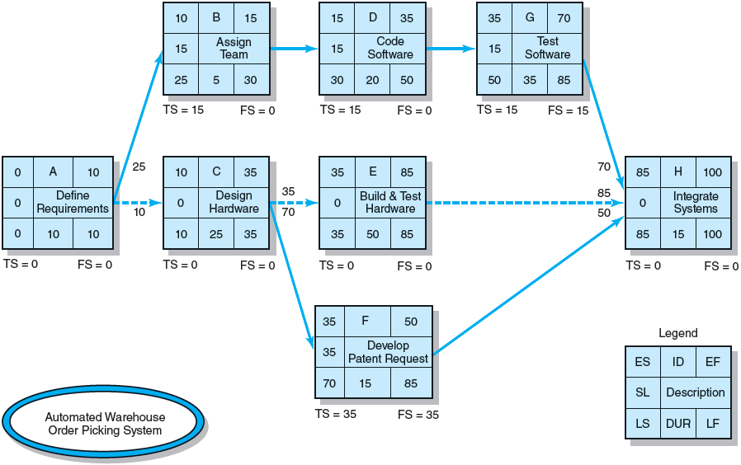
Forward and Backward Passes Completed with Slack Times
FIGURE 6.8
Notes:
Figure 6.8 shows the completed network with all the early, late, and slack times included. Activity G has free slack of 15 days, while activities B and D do not. In this case, activity G is the last activity in the upper path, and it merges to activity H. Hence, to delay activity G up to 15 days does not delay any following activities and requires no coordination with managers of other activities.

Slide 24
Practical Considerations
Network Logic Errors
Activity Numbering
Use of Computers to Develop Networks
Calendar Dates
Multiple Starts and Multiple Projects
Notes:
This slide lists some of the practical considerations that project managers must make when developing networks of activities.

Slide 25
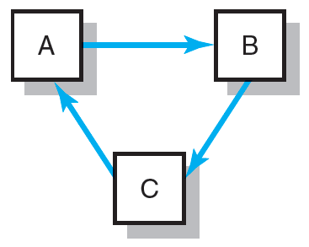
Network Logic Errors: Illogical Loop
FIGURE 6.9
Notes:
Looping is an attempt by the planner to return to an earlier activity. Figure 6.9 shows an illogical loop. If this loop were allowed to exist, this path would perpetually repeat itself. Many computer programs catch this type of logic error.

Slide 26
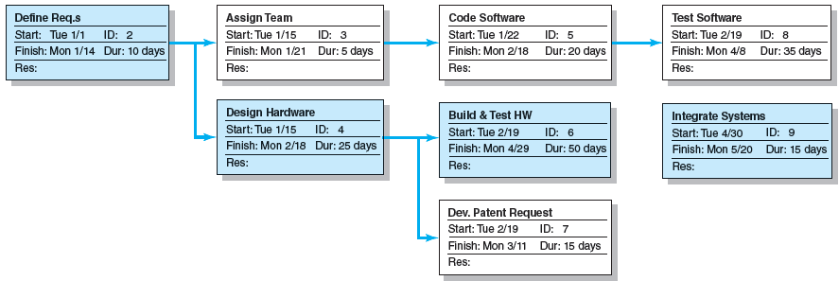
Automated Warehouse Order Picking System Network
FIGURE 6.10
Notes:
Figure 6.10 presents a generic AON computer output for the Automated Warehouse Picking System project that uses numbered boxes to identify activities. The critical path is identified by the shaded nodes (activities) 2, 4, 6, and 9. The activity description is shown on the top line of the activity node box. The activity start time and identification are on the second line. The finish time and duration are on the third line of the node.

Slide 27
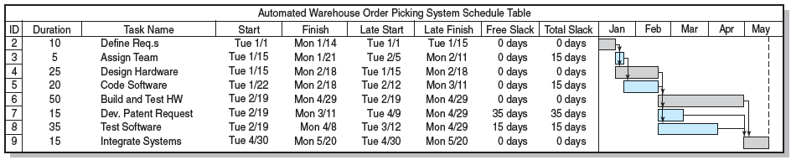
Automated Order Warehouse Picking System Bar Chart
FIGURE 6.11
Notes:
Figure 6.11 presents a time-scaled early start Gantt chart used in planning, resource scheduling, and status reporting an automated warehouse picking system. This format is a two-dimensional representation of the project schedule, with activities down the rows and time across the horizontal axis. The shaded bars at right represent the activity durations. The extended lines from the bars represent slack.

Slide 28
Extended Network Techniques to Come Close to Reality
Laddering
Activities are broken into segments so the following activity can begin sooner and not delay the work.
Lags
The minimum amount of time a dependent activity must be delayed to begin or end.
Lengthy activities are broken down to reduce the delay in the start of successor activities.
Lags can be used to constrain finish-to-start, start-to-start, finish-to-finish, start-to-finish, or combination relationships.
Notes:
Laddering and lags describe network techniques for arranging activity relationships that come closer to the realities of projects where initial outputs from one activity allow the near-immediate start of subsequent activities.

Slide 29
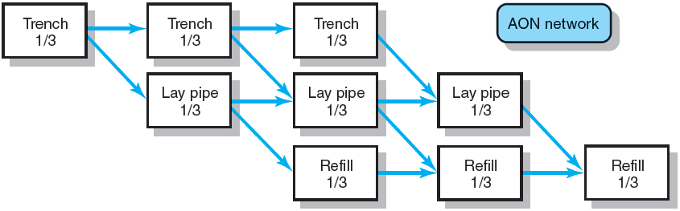
Example of Laddering Using Finish-to-Start Relationship
FIGURE 6.12
Notes:
Figure 6.12 shows how the overlapping activities of a pipe laying project appear in an AON network using the standard finish-to-start approach.

Slide 30

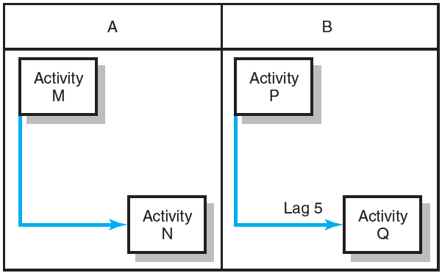
Use of Lags
Finish-to-Start Relationship
FIGURE 6.13
Start-to-Start Relationship
FIGURE 6.14
Notes:
Figure 6.13 shows the finish-to-start relationship that represents the typical, generic network style used in the early part of the chapter. However, there are situations in which the next activity in a sequence must be delayed even when the preceding activity is complete. Figure 6.14 also shows a start-to-start relationship as an alternative in segmenting activities.
It is possible to find compression opportunities by changing finish-to-start relations to start-to-start relationships.

Slide 31
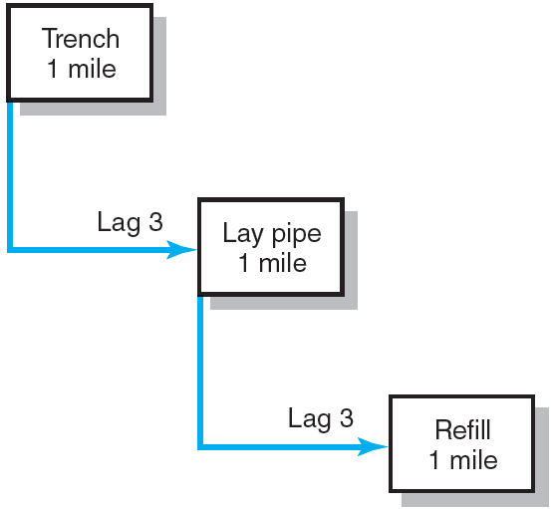
Use of Lags Cont’d
Use of Lags to Reduce Project Duration
FIGURE 6.15
Notes:
Figure 6.15 shows the project using an AON network. The start-to-start relationship reduces network detail and project delays by using lag relationships.

Slide 32
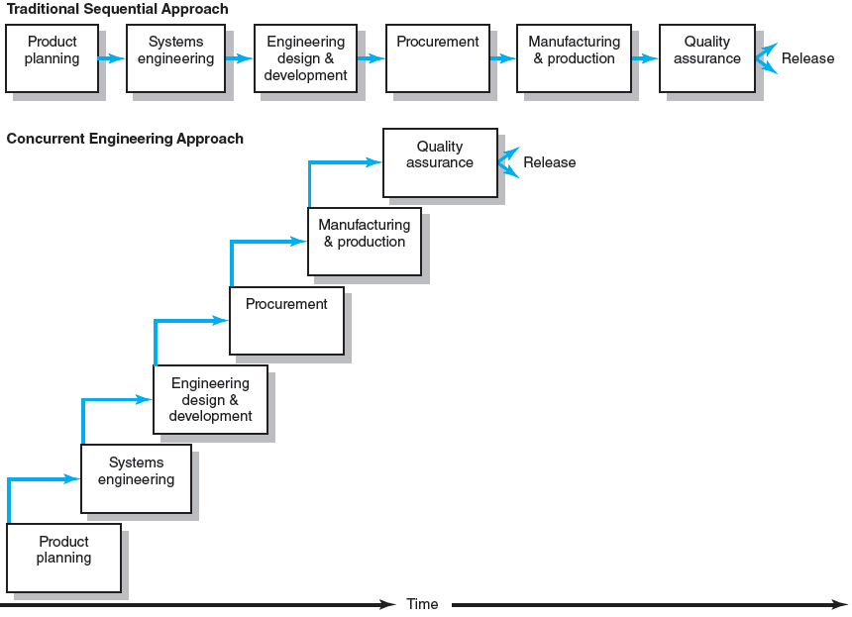
New Product Development Process
FIGURE 6.16
Notes:
Figure 6.16 shows how the concurrent engineering approach expedites projects by breaking activities into smaller segments so that project work can be done in parallel to achieve dramatic time-to-market gains.

Slide 33
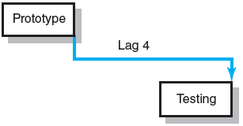
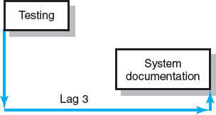
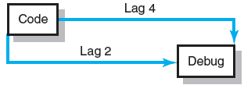
Use of Lags (cont’d)
Finish-to-Finish Relationship
FIGURE 6.17
Start-to-Finish Relationship
FIGURE 6.18
Combination Relationship
FIGURE 6.19
Notes:
The Finish-to-Finish Relationship in Figure 6.17 illustrates how the finish of one activity depends on the finish of another activity.
The Start-to-Finish Relationship in Figure 6.18 represents situations in which the finish of an activity depends on the start of another activity.
Combinations of Lag Relationships in Figure 6.19 shows how more than one lag relationship can be attached to an activity. These relationships are usually start-to-start and finish-to-finish combinations tied to two activities.

Slide 34
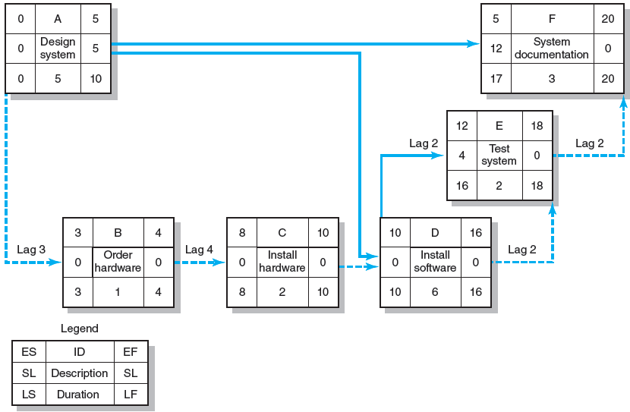
Network Using Lags
FIGURE 6.20
Notes:
Figure 6.20 shows an example of the outcome of the forward and backward pass for a hardware ordering system. Ordering hardware depends upon the design of the system (start-to-start). Three days into the design of the system (activity A), it is possible to order the required hardware (activity B). It takes four days after the order is placed (activity B) for the hardware to arrive so it can begin to be installed (activity C). After two days of installing the software system (activity D), the testing of the system can begin (activity E). System testing (activity E) can be completed two days after the software is installed (activity D). Preparing system documentation (activity F) can begin once the design is completed (activity A), but it cannot be completed until two days after testing the system (activity E). This final relationship is an example of a finish-to-finish lag.

Slide 35
Hammock Activities
Hammock Activity
Spans over a segment of a project.
Has a duration that is determined after the network plan is drawn.
Is used to aggregate sections of the project to facilitate getting the right amount of detail for specific sections of a project.
Is very useful in assigning and controlling indirect project costs.
Notes:
A hammock activity spans over a segment of a project. Duration of hammock activities is determined after the network plan is drawn. Hammock activities are used to aggregate sections of the project to facilitate getting the right amount of detail for specific sections of a project. Hammock activities are very useful in assigning and controlling indirect project costs.

Slide 36
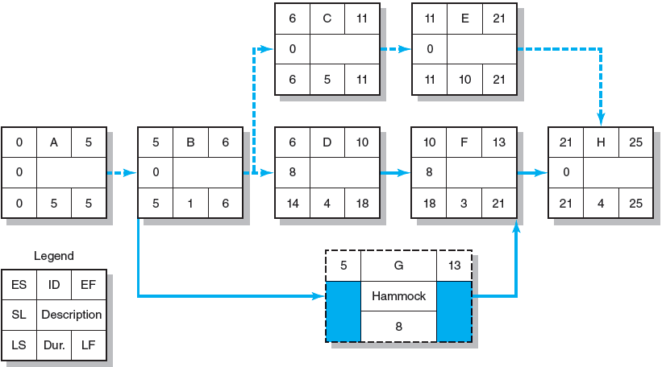
Hammock Activity Example
FIGURE 6.21
Notes:
Figure 6.21 provides an example of a hammock activity used in a network. The duration for the hammock activity is derived from the early start (ES) of activity B and the early finish (EF) of activity F; that is, the difference between 13 and 5, or 8 time units. The hammock duration will change if any ES or EF in the chain-sequence changes.

Slide 37
Key Terms
Activity
Activity-on-arrow (AOA)
Activity-on-node (AON)
Burst activity
Concurrent engineering
Critical path
Early and late times
Free slack
Gantt chart
Hammock activity
Lag relationship
Merge activity
Parallel activity
Sensitivity
Total slack
Notes:
Activity is a task of the project that consumes time while people/equipment either work or wait.
Activity-on-arrow (AOA) is a method for drawing project networks where activity is shown as an arrow.
Activity-on-node (AON) is a method for drawing project networks where the activity is on the node (rectangle).
Burst activity is an activity that has more than one activity immediately following it.
Concurrent engineering is cross-functional teamwork in new-product development projects that provides product design, quality engineering, and manufacturing process engineering all at the same time.
Critical path is the longest activity path(s) through the network that can be distinguished by identifying the collection of activities that all have the same minimum slack.
Early and late times are the earliest (or latest) an activity can start. It is
the largest early (or late) finish of all its immediate predecessors
Free slack is the maximum amount of time an activity can be delayed from its early start (ES) without affecting the early start (ES) of any activity immediately following it.
Gantt chart is a graphic presentation of project activities depicted as a time-scaled bar line.
Hammock activity is a special-purpose, aggregate activity that identifies the use of fixed resources or costs over a segment of the project. Derives its duration from the time span between other activities.
Lag relationship is the relationship between the start and/ or finish of a project activity and the start and/or finish of another activity.
Merge activity is an activity that has more than one activity immediately preceding it
Parallel activity describes one or more activities that can be carried on concurrently or simultaneously.
Sensitivity is the likelihood that the critical path(s) will change once the project begins to be implemented.
Total slack is the amount of time an activity can be delayed and not affect the project duration (TS = LS - ES or LF - EF).

Slide 38
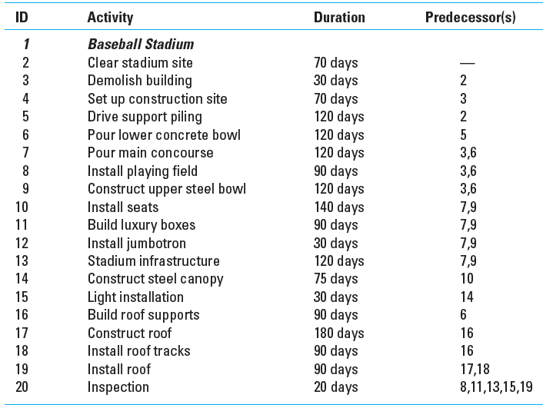
Greendale Stadium Case
TABLE 6.3
Notes:
Table 6.3 lists the network activities, their durations, and predecessors for the Greendale Stadium Case.

